Slide 1
Miller-Rabin overcomes the major flaw of Fermat’s Primality Test
INSERT
VIDEO
HERE

Slide 2
Miller-Rabin overcomes the major flaw of Fermat’s Primality Test
Fermat’s Primality Test efficient, but flawed
INSERT
VIDEO
HERE

Slide 3
Miller-Rabin overcomes the major flaw of Fermat’s Primality Test
Fermat’s Primality Test efficient, but flawed
Other tests available
INSERT
VIDEO
HERE

Slide 4
Miller-Rabin overcomes the major flaw of Fermat’s Primality Test
Fermat’s Primality Test efficient, but flawed
Other tests available
Greater certainly, but slower and more complicated
INSERT
VIDEO
HERE

Slide 5
Miller-Rabin overcomes the major flaw of Fermat’s Primality Test
Fermat’s Primality Test efficient, but flawed
Other tests available
Greater certainly, but slower and more complicated
Deterministic tests generally too slow for practicality
INSERT
VIDEO
HERE

Slide 6
Miller-Rabin overcomes the major flaw of Fermat’s Primality Test
Fermat’s Primality Test efficient, but flawed
Other tests available
Greater certainly, but slower and more complicated
Deterministic tests generally too slow for practicality
Miller-Rabin a very commonly used probabilistic test
INSERT
VIDEO
HERE

Slide 7
Miller-Rabin overcomes the major flaw of Fermat’s Primality Test
Fermat’s Primality Test efficient, but flawed
Other tests available
Greater certainly, but slower and more complicated
Deterministic tests generally too slow for practicality
Miller-Rabin a very commonly used probabilistic test
Based on behavior of modular square roots
INSERT
VIDEO
HERE

Slide 8
Miller-Rabin overcomes the major flaw of Fermat’s Primality Test
Fermat’s Primality Test efficient, but flawed
Other tests available
Greater certainly, but slower and more complicated
Deterministic tests generally too slow for practicality
Miller-Rabin a very commonly used probabilistic test
Based on behavior of modular square roots
Uses Fermat’s Little Theorem to exploit this behavior
INSERT
VIDEO
HERE

Slide 9
There can be more than two square roots of 1
INSERT
VIDEO
HERE

Slide 10

There can be more than two square roots of 1
$$x^{2}≡1 \left(mod n\right)$$
INSERT
VIDEO
HERE

Slide 11

There can be more than two square roots of 1
$$x^{2}≡1 \left(mod n\right)$$
Always two trivial solutions: x ≡ {1, -1} (mod n)
INSERT
VIDEO
HERE

Slide 12
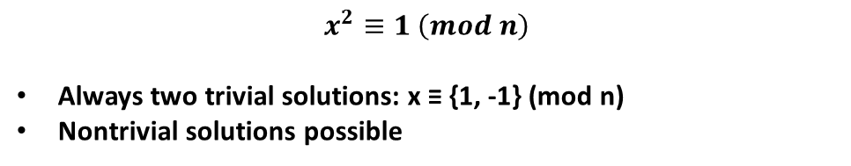
There can be more than two square roots of 1
$$x^{2}≡1 \left(mod n\right)$$
Always two trivial solutions: x ≡ {1, -1} (mod n)
Nontrivial solutions possible
INSERT
VIDEO
HERE

Slide 13
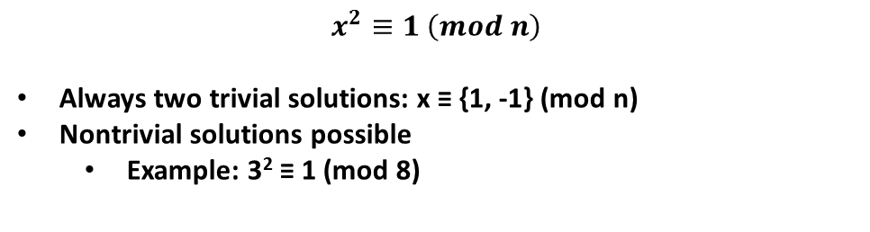
There can be more than two square roots of 1
$$x^{2}≡1 \left(mod n\right)$$
Always two trivial solutions: x ≡ {1, -1} (mod n)
Nontrivial solutions possible
Example: 3² ≡ 1 (mod 8)
INSERT
VIDEO
HERE

Slide 14
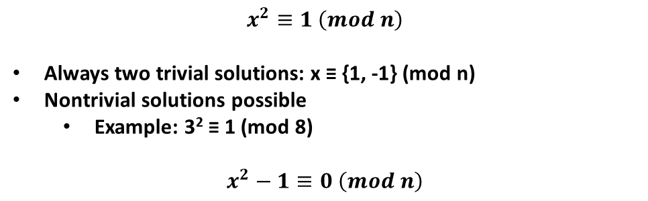
There can be more than two square roots of 1
$$x^{2}≡1 \left(mod n\right)$$
Always two trivial solutions: x ≡ {1, -1} (mod n)
Nontrivial solutions possible
Example: 3² ≡ 1 (mod 8)
$$x^{2}−1≡0 \left(mod n\right)$$
INSERT
VIDEO
HERE

Slide 15
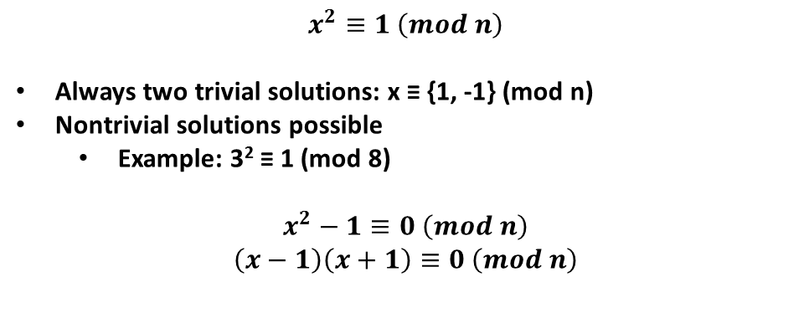
There can be more than two square roots of 1
$$x^{2}≡1 \left(mod n\right)$$
Always two trivial solutions: x ≡ {1, -1} (mod n)
Nontrivial solutions possible
Example: 3² ≡ 1 (mod 8)
$$x^{2}−1≡0 \left(mod n\right)$$
$$\left(x−1\right)\left(x+1\right)≡0 \left(mod n\right)$$
INSERT
VIDEO
HERE

Slide 16
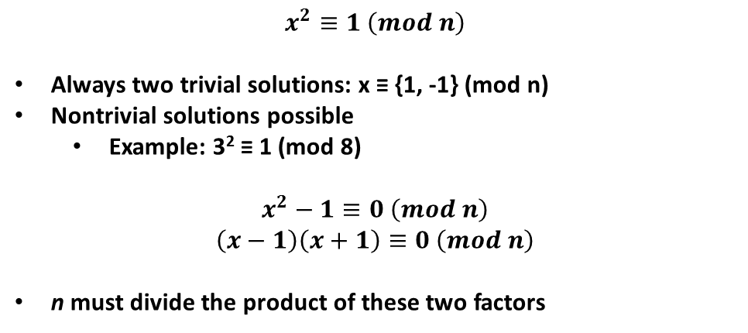
There can be more than two square roots of 1
$$x^{2}≡1 \left(mod n\right)$$
Always two trivial solutions: x ≡ {1, -1} (mod n)
Nontrivial solutions possible
Example: 3² ≡ 1 (mod 8)
$$x^{2}−1≡0 \left(mod n\right)$$
$$\left(x−1\right)\left(x+1\right)≡0 \left(mod n\right)$$
n must divide the product of these two factors
INSERT
VIDEO
HERE

Slide 17
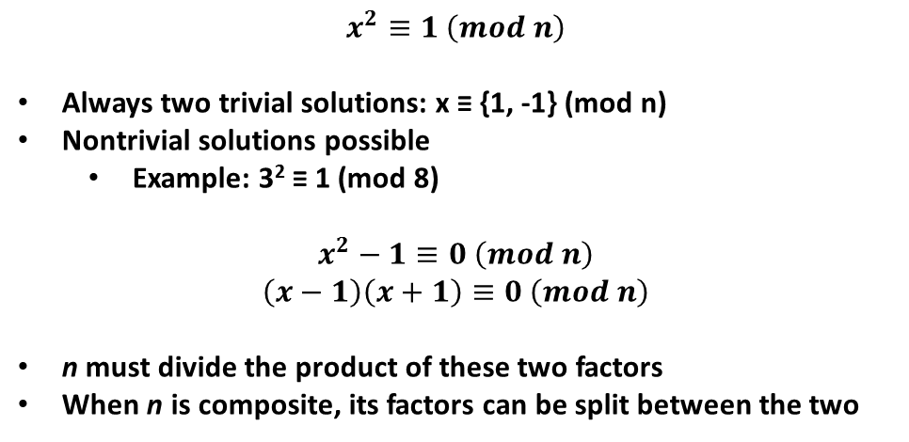
There can be more than two square roots of 1
$$x^{2}≡1 \left(mod n\right)$$
Always two trivial solutions: x ≡ {1, -1} (mod n)
Nontrivial solutions possible
Example: 3² ≡ 1 (mod 8)
$$x^{2}−1≡0 \left(mod n\right)$$
$$\left(x−1\right)\left(x+1\right)≡0 \left(mod n\right)$$
n must divide the product of these two factors
When n is composite, its factors can be split between the two
INSERT
VIDEO
HERE

Slide 18
There can be more than two square roots of 1 EXCEPT when the modulus is prime
INSERT
VIDEO
HERE

Slide 19
There can be more than two square roots of 1 EXCEPT when the modulus is prime
IF n is prime,
INSERT
VIDEO
HERE

Slide 20
There can be more than two square roots of 1 EXCEPT when the modulus is prime
IF n is prime,
It must divide either (x-1) or (x+1)
INSERT
VIDEO
HERE

Slide 21
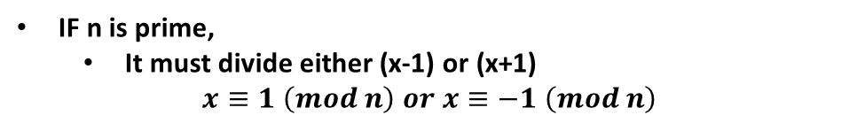
There can be more than two square roots of 1 EXCEPT when the modulus is prime
IF n is prime,
It must divide either (x-1) or (x+1)
$$x≡1 \left(mod n\right) or x≡−1 \left(mod n\right)$$
INSERT
VIDEO
HERE

Slide 22
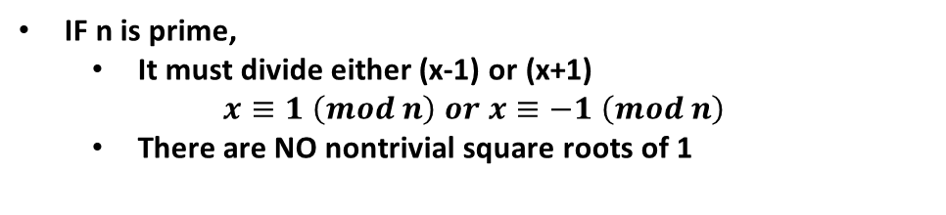
There can be more than two square roots of 1 EXCEPT when the modulus is prime
IF n is prime,
It must divide either (x-1) or (x+1)
$$x≡1 \left(mod n\right) or x≡−1 \left(mod n\right)$$
There are NO nontrivial square roots of 1
INSERT
VIDEO
HERE

Slide 23
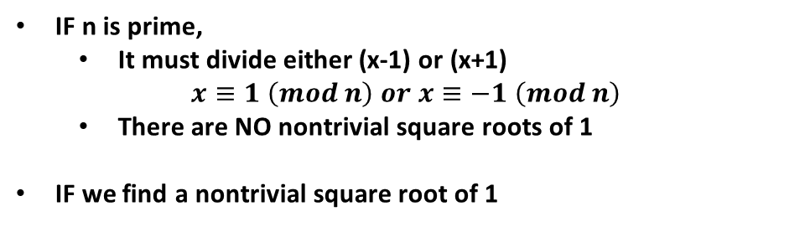
There can be more than two square roots of 1 EXCEPT when the modulus is prime
IF n is prime,
It must divide either (x-1) or (x+1)
$$x≡1 \left(mod n\right) or x≡−1 \left(mod n\right)$$
There are NO nontrivial square roots of 1
IF we find a nontrivial square root of 1
INSERT
VIDEO
HERE

Slide 24
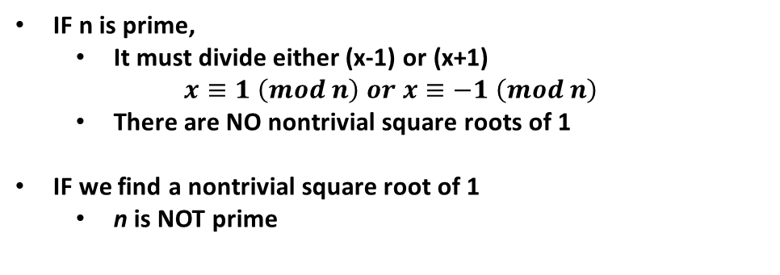
There can be more than two square roots of 1 EXCEPT when the modulus is prime
IF n is prime,
It must divide either (x-1) or (x+1)
$$x≡1 \left(mod n\right) or x≡−1 \left(mod n\right)$$
There are NO nontrivial square roots of 1
IF we find a nontrivial square root of 1
n is NOT prime
INSERT
VIDEO
HERE

Slide 25
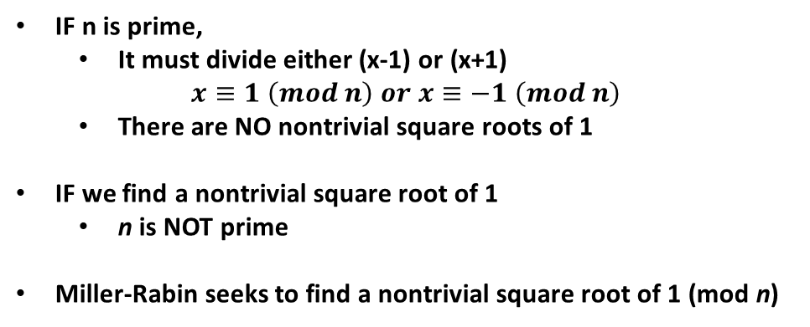
There can be more than two square roots of 1 EXCEPT when the modulus is prime
IF n is prime,
It must divide either (x-1) or (x+1)
$$x≡1 \left(mod n\right) or x≡−1 \left(mod n\right)$$
There are NO nontrivial square roots of 1
IF we find a nontrivial square root of 1
n is NOT prime
Miller-Rabin seeks to find a nontrivial square root of 1 (mod n)
INSERT
VIDEO
HERE

Slide 26
Fermat’s Little Theorem lets us cheat
INSERT
VIDEO
HERE

Slide 27
Fermat’s Little Theorem lets us cheat
$$a^{\left(n−1\right)}≡1 \left(mod n\right); IF n is prime$$
INSERT
VIDEO
HERE

Slide 28

Fermat’s Little Theorem lets us cheat
$$a^{\left(n−1\right)}≡1 \left(mod n\right); IF n is prime$$
Start with carefully chosen value of a^{d} such that
INSERT
VIDEO
HERE

Slide 29
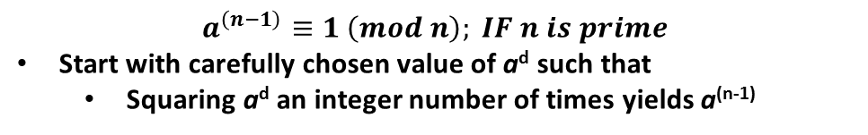
Fermat’s Little Theorem lets us cheat
$$a^{\left(n−1\right)}≡1 \left(mod n\right); IF n is prime$$
Start with carefully chosen value of a^{d} such that
Squaring a^{d} an integer number of times yields a^{(n-1)}
INSERT
VIDEO
HERE

Slide 30
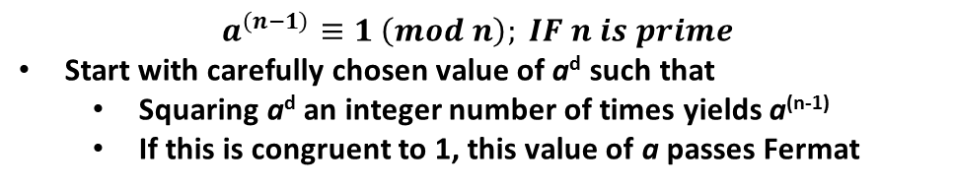
Fermat’s Little Theorem lets us cheat
$$a^{\left(n−1\right)}≡1 \left(mod n\right); IF n is prime$$
Start with carefully chosen value of a^{d} such that
Squaring a^{d} an integer number of times yields a^{(n-1)}
If this is congruent to 1, this value of a passes Fermat
INSERT
VIDEO
HERE

Slide 31
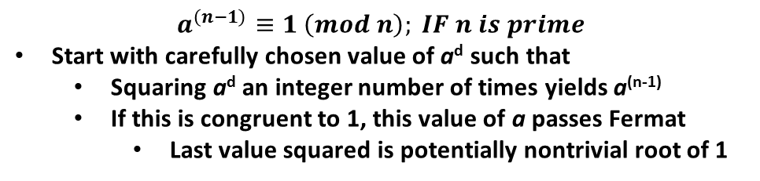
Fermat’s Little Theorem lets us cheat
$$a^{\left(n−1\right)}≡1 \left(mod n\right); IF n is prime$$
Start with carefully chosen value of a^{d} such that
Squaring a^{d} an integer number of times yields a^{(n-1)}
If this is congruent to 1, this value of a passes Fermat
Last value squared is potentially nontrivial root of 1
INSERT
VIDEO
HERE

Slide 32
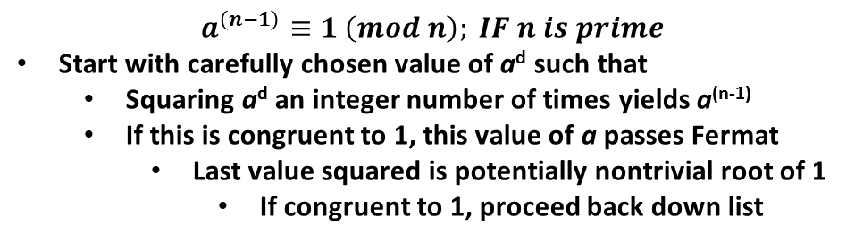
Fermat’s Little Theorem lets us cheat
$$a^{\left(n−1\right)}≡1 \left(mod n\right); IF n is prime$$
Start with carefully chosen value of a^{d} such that
Squaring a^{d} an integer number of times yields a^{(n-1)}
If this is congruent to 1, this value of a passes Fermat
Last value squared is potentially nontrivial root of 1
If congruent to 1, proceed back down list
INSERT
VIDEO
HERE

Slide 33
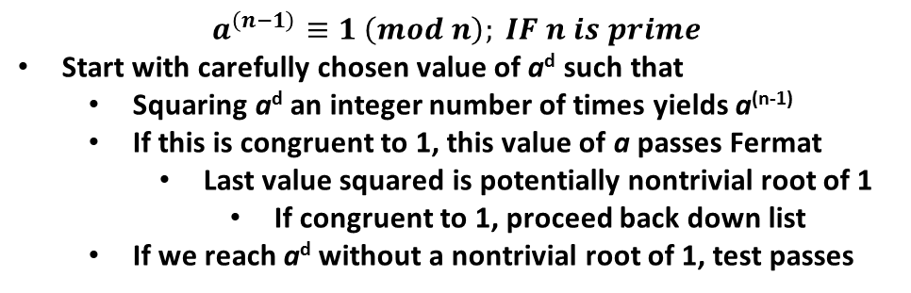
Fermat’s Little Theorem lets us cheat
$$a^{\left(n−1\right)}≡1 \left(mod n\right); IF n is prime$$
Start with carefully chosen value of a^{d} such that
Squaring a^{d} an integer number of times yields a^{(n-1)}
If this is congruent to 1, this value of a passes Fermat
Last value squared is potentially nontrivial root of 1
If congruent to 1, proceed back down list
If we reach a^{d} without a nontrivial root of 1, test passes
INSERT
VIDEO
HERE

Slide 34
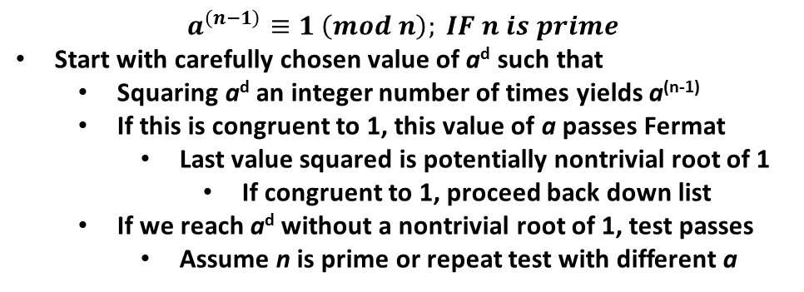
Fermat’s Little Theorem lets us cheat
$$a^{\left(n−1\right)}≡1 \left(mod n\right); IF n is prime$$
Start with carefully chosen value of a^{d} such that
Squaring a^{d} an integer number of times yields a^{(n-1)}
If this is congruent to 1, this value of a passes Fermat
Last value squared is potentially nontrivial root of 1
If congruent to 1, proceed back down list
If we reach a^{d} without a nontrivial root of 1, test passes
Assume n is prime or repeat test with different a
INSERT
VIDEO
HERE

Slide 35
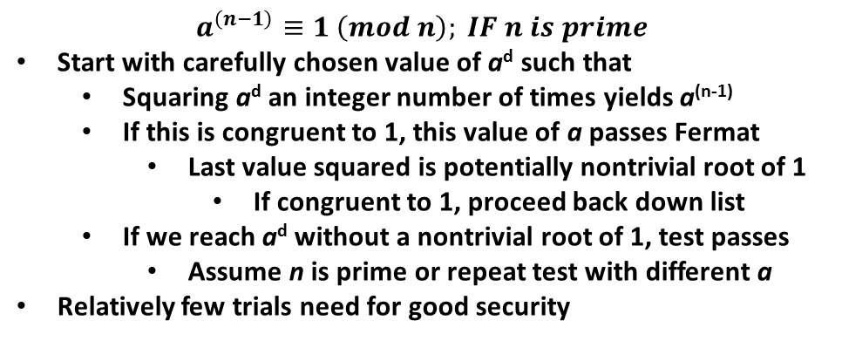
Fermat’s Little Theorem lets us cheat
$$a^{\left(n−1\right)}≡1 \left(mod n\right); IF n is prime$$
Start with carefully chosen value of a^{d} such that
Squaring a^{d} an integer number of times yields a^{(n-1)}
If this is congruent to 1, this value of a passes Fermat
Last value squared is potentially nontrivial root of 1
If congruent to 1, proceed back down list
If we reach a^{d} without a nontrivial root of 1, test passes
Assume n is prime or repeat test with different a
Relatively few trials need for good security
INSERT
VIDEO
HERE

Slide 36
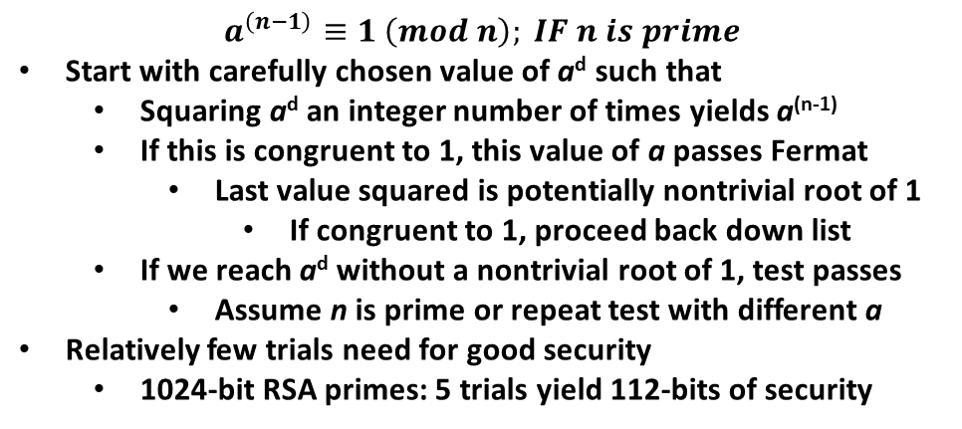
Fermat’s Little Theorem lets us cheat
$$a^{\left(n−1\right)}≡1 \left(mod n\right); IF n is prime$$
Start with carefully chosen value of a^{d} such that
Squaring a^{d} an integer number of times yields a^{(n-1)}
If this is congruent to 1, this value of a passes Fermat
Last value squared is potentially nontrivial root of 1
If congruent to 1, proceed back down list
If we reach a^{d} without a nontrivial root of 1, test passes
Assume n is prime or repeat test with different a
Relatively few trials need for good security
1024-bit RSA primes: 5 trials yield 112-bits of security
INSERT
VIDEO
HERE

Slide 37
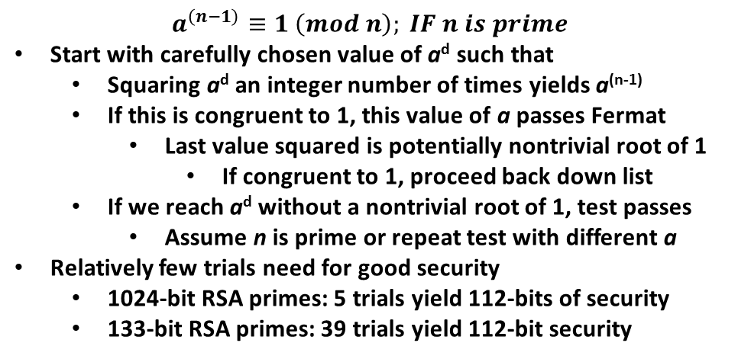
Fermat’s Little Theorem lets us cheat
$$a^{\left(n−1\right)}≡1 \left(mod n\right); IF n is prime$$
Start with carefully chosen value of a^{d} such that
Squaring a^{d} an integer number of times yields a^{(n-1)}
If this is congruent to 1, this value of a passes Fermat
Last value squared is potentially nontrivial root of 1
If congruent to 1, proceed back down list
If we reach a^{d} without a nontrivial root of 1, test passes
Assume n is prime or repeat test with different a
Relatively few trials need for good security
1024-bit RSA primes: 5 trials yield 112-bits of security
133-bit RSA primes: 39 trials yield 112-bit security
INSERT
VIDEO
HERE

Slide 38
Choosing the proper value for a^{d} is as simple as dividing by two
INSERT
VIDEO
HERE

Slide 39
Choosing the proper value for a^{d} is as simple as dividing by two
How to carefully choose a^{d}
INSERT
VIDEO
HERE

Slide 40
Choosing the proper value for a^{d} is as simple as dividing by two
How to carefully choose a^{d}
Since n is odd, (n-1) is even (and divisible by 2)
INSERT
VIDEO
HERE

Slide 41
Choosing the proper value for a^{d} is as simple as dividing by two
How to carefully choose a^{d}
Since n is odd, (n-1) is even (and divisible by 2)
Pull all s 2’s out, making (n-1) = 2^{s}·d, with d odd
INSERT
VIDEO
HERE

Slide 42
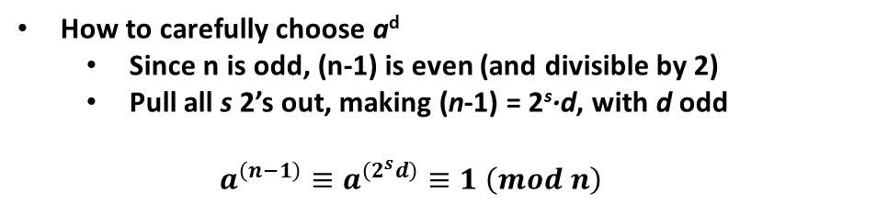
Choosing the proper value for a^{d} is as simple as dividing by two
How to carefully choose a^{d}
Since n is odd, (n-1) is even (and divisible by 2)
Pull all s 2’s out, making (n-1) = 2^{s}·d, with d odd
$$a^{\left(n−1\right)}≡a^{\left(2^{s}d\right)}≡1 \left(mod n\right)$$
INSERT
VIDEO
HERE

Slide 43
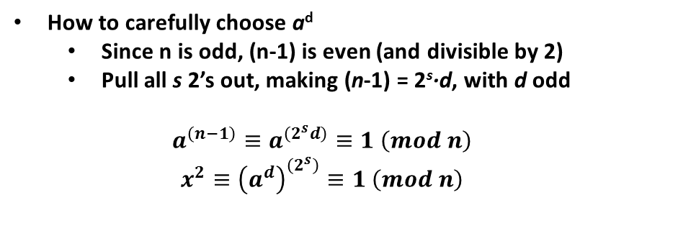
Choosing the proper value for a^{d} is as simple as dividing by two
How to carefully choose a^{d}
Since n is odd, (n-1) is even (and divisible by 2)
Pull all s 2’s out, making (n-1) = 2^{s}·d, with d odd
$$a^{\left(n−1\right)}≡a^{\left(2^{s}d\right)}≡1 \left(mod n\right)$$
$$x^{2}≡{\left(a^{d}\right)}^{\left(2^{s}\right)}≡1 \left(mod n\right)$$
INSERT
VIDEO
HERE

Slide 44
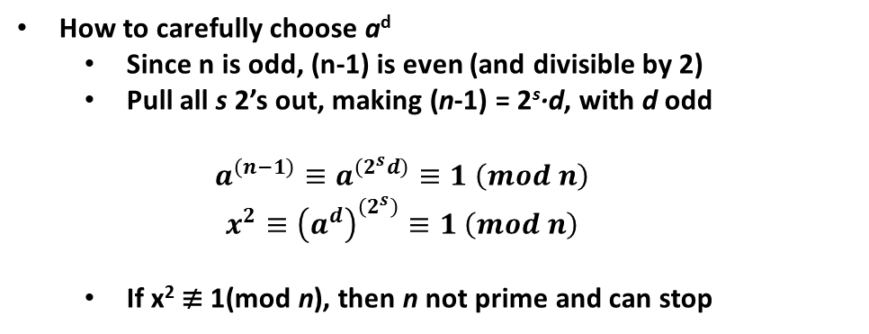
Choosing the proper value for a^{d} is as simple as dividing by two
How to carefully choose a^{d}
Since n is odd, (n-1) is even (and divisible by 2)
Pull all s 2’s out, making (n-1) = 2^{s}·d, with d odd
$$a^{\left(n−1\right)}≡a^{\left(2^{s}d\right)}≡1 \left(mod n\right)$$
$$x^{2}≡{\left(a^{d}\right)}^{\left(2^{s}\right)}≡1 \left(mod n\right)$$
If x² ≢ 1(mod n), then n not prime and can stop
INSERT
VIDEO
HERE

Slide 45
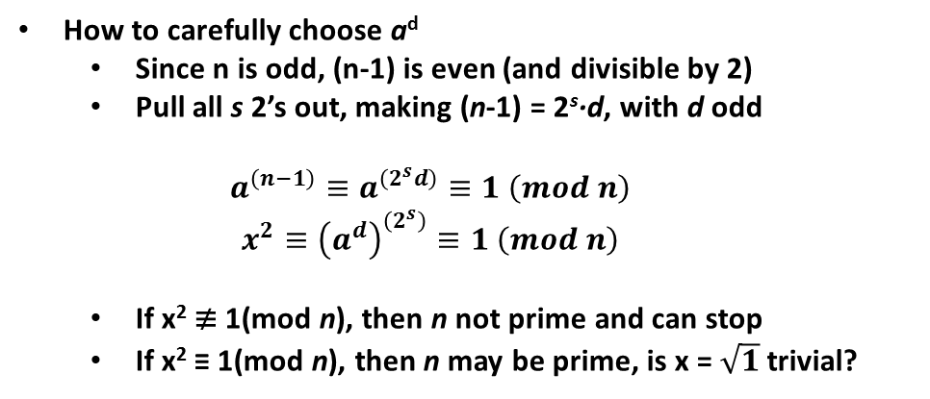
Choosing the proper value for a^{d} is as simple as dividing by two
How to carefully choose a^{d}
Since n is odd, (n-1) is even (and divisible by 2)
Pull all s 2’s out, making (n-1) = 2^{s}·d, with d odd
$$a^{\left(n−1\right)}≡a^{\left(2^{s}d\right)}≡1 \left(mod n\right)$$
$$x^{2}≡{\left(a^{d}\right)}^{\left(2^{s}\right)}≡1 \left(mod n\right)$$
If x² ≢ 1(mod n), then n not prime and can stop
If x² ≡ 1(mod n), then n may be prime, is x = $\sqrt{1}$trivial?
INSERT
VIDEO
HERE

Slide 46
Conceptual algorithm designed downward , but implementation is a simple loop flowing upward
INSERT
VIDEO
HERE

Slide 47

Conceptual algorithm designed downward , but implementation is a simple loop flowing upward
$$x=\sqrt{{\left(a^{d}\right)}^{\left(2^{s}\right)}}≡{\left(a^{d}\right)}^{\left(2^{\left(s−1\right)}\right)}$$
INSERT
VIDEO
HERE

Slide 48
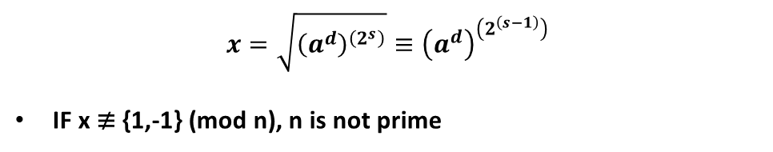
Conceptual algorithm designed downward , but implementation is a simple loop flowing upward
$$x=\sqrt{{\left(a^{d}\right)}^{\left(2^{s}\right)}}≡{\left(a^{d}\right)}^{\left(2^{\left(s−1\right)}\right)}$$
IF x ≢ {1,-1} (mod n), n is not prime
INSERT
VIDEO
HERE

Slide 49
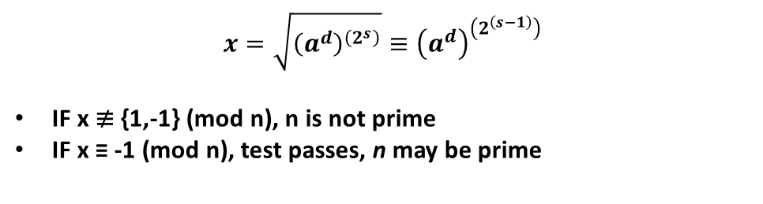
Conceptual algorithm designed downward , but implementation is a simple loop flowing upward
$$x=\sqrt{{\left(a^{d}\right)}^{\left(2^{s}\right)}}≡{\left(a^{d}\right)}^{\left(2^{\left(s−1\right)}\right)}$$
IF x ≢ {1,-1} (mod n), n is not prime
IF x ≡ -1 (mod n), test passes, n may be prime
INSERT
VIDEO
HERE

Slide 50
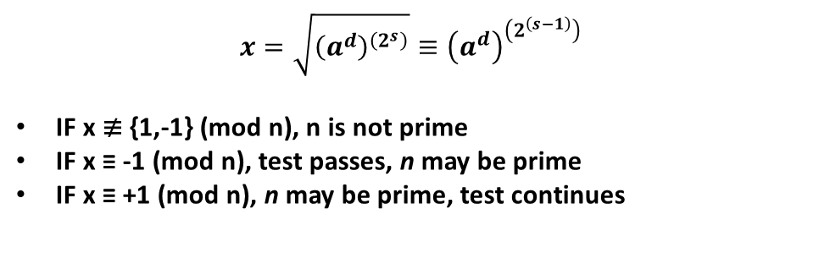
Conceptual algorithm designed downward , but implementation is a simple loop flowing upward
$$x=\sqrt{{\left(a^{d}\right)}^{\left(2^{s}\right)}}≡{\left(a^{d}\right)}^{\left(2^{\left(s−1\right)}\right)}$$
IF x ≢ {1,-1} (mod n), n is not prime
IF x ≡ -1 (mod n), test passes, n may be prime
IF x ≡ +1 (mod n), n may be prime, test continues
INSERT
VIDEO
HERE

Slide 51
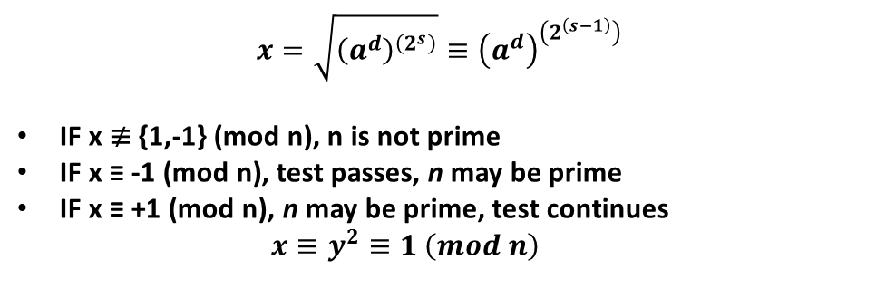
Conceptual algorithm designed downward , but implementation is a simple loop flowing upward
$$x=\sqrt{{\left(a^{d}\right)}^{\left(2^{s}\right)}}≡{\left(a^{d}\right)}^{\left(2^{\left(s−1\right)}\right)}$$
IF x ≢ {1,-1} (mod n), n is not prime
IF x ≡ -1 (mod n), test passes, n may be prime
IF x ≡ +1 (mod n), n may be prime, test continues
$$x≡y^{2}≡1 \left(mod n\right)$$
INSERT
VIDEO
HERE

Slide 52
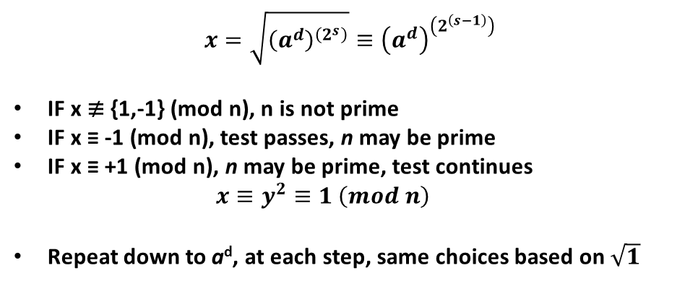
Conceptual algorithm designed downward , but implementation is a simple loop flowing upward
$$x=\sqrt{{\left(a^{d}\right)}^{\left(2^{s}\right)}}≡{\left(a^{d}\right)}^{\left(2^{\left(s−1\right)}\right)}$$
IF x ≢ {1,-1} (mod n), n is not prime
IF x ≡ -1 (mod n), test passes, n may be prime
IF x ≡ +1 (mod n), n may be prime, test continues
$$x≡y^{2}≡1 \left(mod n\right)$$
Repeat down to a^{d}, at each step, same choices based on$\sqrt{1}$
INSERT
VIDEO
HERE

Slide 53
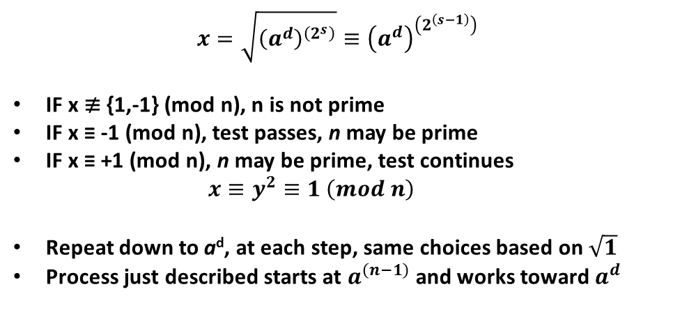
Conceptual algorithm designed downward , but implementation is a simple loop flowing upward
$$x=\sqrt{{\left(a^{d}\right)}^{\left(2^{s}\right)}}≡{\left(a^{d}\right)}^{\left(2^{\left(s−1\right)}\right)}$$
IF x ≢ {1,-1} (mod n), n is not prime
IF x ≡ -1 (mod n), test passes, n may be prime
IF x ≡ +1 (mod n), n may be prime, test continues
$$x≡y^{2}≡1 \left(mod n\right)$$
Repeat down to a^{d}, at each step, same choices based on$\sqrt{1}$
Process just described starts at $a^{\left(n−1\right)}$and works toward $a^{d}$
INSERT
VIDEO
HERE

Slide 54
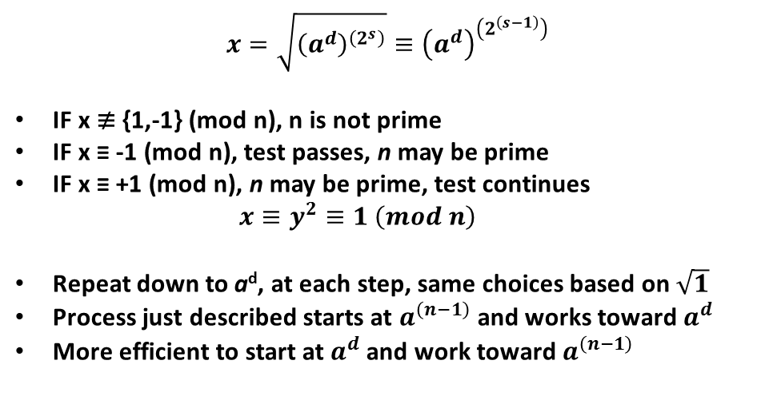
Conceptual algorithm designed downward , but implementation is a simple loop flowing upward
$$x=\sqrt{{\left(a^{d}\right)}^{\left(2^{s}\right)}}≡{\left(a^{d}\right)}^{\left(2^{\left(s−1\right)}\right)}$$
IF x ≢ {1,-1} (mod n), n is not prime
IF x ≡ -1 (mod n), test passes, n may be prime
IF x ≡ +1 (mod n), n may be prime, test continues
$$x≡y^{2}≡1 \left(mod n\right)$$
Repeat down to a^{d}, at each step, same choices based on$\sqrt{1}$
Process just described starts at $a^{\left(n−1\right)}$and works toward $a^{d}$
More efficient to start at $a^{d}$and work toward$a^{\left(n−1\right)}$
INSERT
VIDEO
HERE

Slide 55
Tree of possible paths reveals the key to simple, fast, efficient implementation
INSERT
VIDEO
HERE

Slide 56

Tree of possible paths reveals the key to simple, fast, efficient implementation
$$x_{i}≡{\left(a^{d}\right)}^{\left(2^{i}\right)}$$
INSERT
VIDEO
HERE

Slide 57
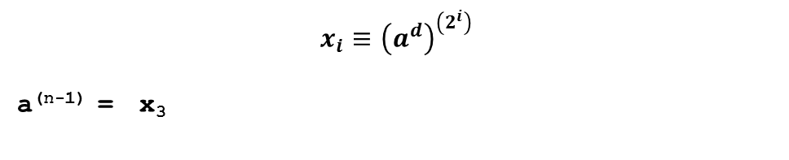
Tree of possible paths reveals the key to simple, fast, efficient implementation
$$x_{i}≡{\left(a^{d}\right)}^{\left(2^{i}\right)}$$
a^{(n-1)} = x₃
INSERT
VIDEO
HERE

Slide 58
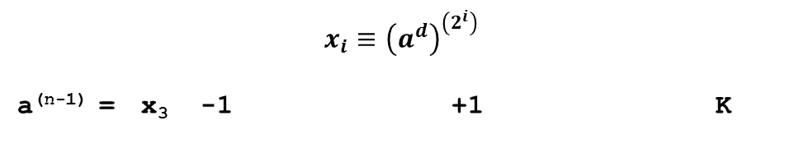
Tree of possible paths reveals the key to simple, fast, efficient implementation
$$x_{i}≡{\left(a^{d}\right)}^{\left(2^{i}\right)}$$
a^{(n-1)} = x₃ -1 +1 K
INSERT
VIDEO
HERE

Slide 59
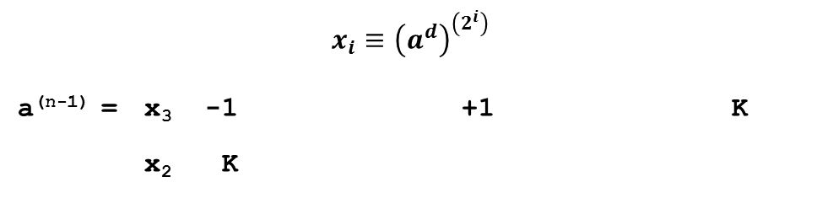
Tree of possible paths reveals the key to simple, fast, efficient implementation
$$x_{i}≡{\left(a^{d}\right)}^{\left(2^{i}\right)}$$
a^{(n-1)} = x₃ -1 +1 K
x₂ K
INSERT
VIDEO
HERE

Slide 60
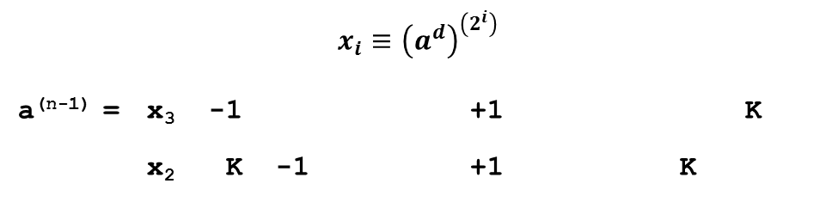
Tree of possible paths reveals the key to simple, fast, efficient implementation
$$x_{i}≡{\left(a^{d}\right)}^{\left(2^{i}\right)}$$
a^{(n-1)} = x₃ -1 +1 K
x₂ K -1 +1 K
INSERT
VIDEO
HERE

Slide 61
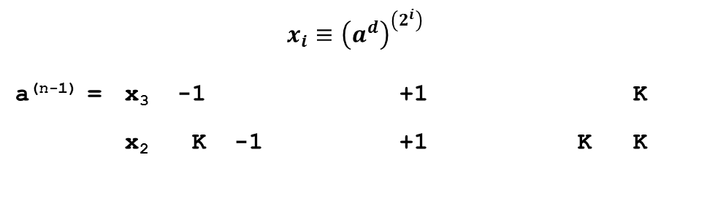
Tree of possible paths reveals the key to simple, fast, efficient implementation
$$x_{i}≡{\left(a^{d}\right)}^{\left(2^{i}\right)}$$
a^{(n-1)} = x₃ -1 +1 K
x₂ K -1 +1 K K
INSERT
VIDEO
HERE

Slide 62

Tree of possible paths reveals the key to simple, fast, efficient implementation
$$x_{i}≡{\left(a^{d}\right)}^{\left(2^{i}\right)}$$
a^{(n-1)} = x₃ -1 +1 K
x₂ K -1 +1 K K
x₁ K K -1 +1 K K K
a^{d} = x₀ K K K -1 +1 K K K K
INSERT
VIDEO
HERE

Slide 63

Tree of possible paths reveals the key to simple, fast, efficient implementation
$$x_{i}≡{\left(a^{d}\right)}^{\left(2^{i}\right)}$$
a^{(n-1)} = x₃ -1 +1 K
x₂ K -1 +1 K K
x₁ K K -1 +1 K K K
a^{d} = x₀ K K K -1 +1 K K K K
RESULT: P P P P
INSERT
VIDEO
HERE

Slide 64

Tree of possible paths reveals the key to simple, fast, efficient implementation
$$x_{i}≡{\left(a^{d}\right)}^{\left(2^{i}\right)}$$
a^{(n-1)} = x₃ -1 +1 K
x₂ K -1 +1 K K
x₁ K K -1 +1 K K K
a^{d} = x₀ K K K -1 +1 K K K K
RESULT: P P P P P
INSERT
VIDEO
HERE

Slide 65

Tree of possible paths reveals the key to simple, fast, efficient implementation
$$x_{i}≡{\left(a^{d}\right)}^{\left(2^{i}\right)}$$
a^{(n-1)} = x₃ -1 +1 K
x₂ K -1 +1 K K
x₁ K K -1 +1 K K K
a^{d} = x₀ K K K -1 +1 K K K K
RESULT: P P P P P C C C C
INSERT
VIDEO
HERE

Slide 66
Tree of possible paths reveals the key to simple, fast, efficient implementation
$$x_{i}≡{\left(a^{d}\right)}^{\left(2^{i}\right)}$$
a^{(n-1)} = x₃ -1 +1 K
x₂ K -1 +1 K K
x₁ K K -1 +1 K K K
a^{d} = x₀ K K K -1 +1 K K K K
RESULT: P P P P P C C C C
INSERT
VIDEO
HERE

Slide 67
Tree of possible paths reveals the key to simple, fast, efficient implementation
$$x_{i}≡{\left(a^{d}\right)}^{\left(2^{i}\right)}$$
a^{(n-1)} = x₃ -1 +1 K
x₂ K -1 +1 K K
x₁ K K -1 +1 K K K
a^{d} = x₀ K K K -1 +1 K K K K
RESULT: P P P P P C C C C
INSERT
VIDEO
HERE

Slide 68
Miller-Rabin is actually quite tame
INSERT
VIDEO
HERE

Slide 69
Miller-Rabin is actually quite tame
Pick a random value for n
INSERT
VIDEO
HERE

Slide 70
Miller-Rabin is actually quite tame
Pick a random value for n
Prefilter with sieve or Fermat’s Primality Test if desired
INSERT
VIDEO
HERE

Slide 71
Miller-Rabin is actually quite tame
Pick a random value for n
Prefilter with sieve or Fermat’s Primality Test if desired
Compute (n-1)
INSERT
VIDEO
HERE

Slide 72
Miller-Rabin is actually quite tame
Pick a random value for n
Prefilter with sieve or Fermat’s Primality Test if desired
Compute (n-1)
Determine the value of s
INSERT
VIDEO
HERE

Slide 73
Miller-Rabin is actually quite tame
Pick a random value for n
Prefilter with sieve or Fermat’s Primality Test if desired
Compute (n-1)
Determine the value of s
Number of times division by 2 needed to get an odd d
INSERT
VIDEO
HERE

Slide 74
Miller-Rabin is actually quite tame
Pick a random value for n
Prefilter with sieve or Fermat’s Primality Test if desired
Compute (n-1)
Determine the value of s
Number of times division by 2 needed to get an odd d
Calculate x ≡ a^{d}
INSERT
VIDEO
HERE

Slide 75
Miller-Rabin is actually quite tame
Pick a random value for n
Prefilter with sieve or Fermat’s Primality Test if desired
Compute (n-1)
Determine the value of s
Number of times division by 2 needed to get an odd d
Calculate x ≡ a^{d}
If congruent to -1, +1, end test with PASS (possible prime)
INSERT
VIDEO
HERE

Slide 76
Miller-Rabin is actually quite tame
Pick a random value for n
Prefilter with sieve or Fermat’s Primality Test if desired
Compute (n-1)
Determine the value of s
Number of times division by 2 needed to get an odd d
Calculate x ≡ a^{d}
If congruent to -1, +1, end test with PASS (possible prime)
Square x a total of s times and, at each step
INSERT
VIDEO
HERE

Slide 77
Miller-Rabin is actually quite tame
Pick a random value for n
Prefilter with sieve or Fermat’s Primality Test if desired
Compute (n-1)
Determine the value of s
Number of times division by 2 needed to get an odd d
Calculate x ≡ a^{d}
If congruent to -1, +1, end test with PASS (possible prime)
Square x a total of s times and, at each step
If x ≡ -1 (mod n), end test with PASS (possible prime)
INSERT
VIDEO
HERE

Slide 78
Miller-Rabin is actually quite tame
Pick a random value for n
Prefilter with sieve or Fermat’s Primality Test if desired
Compute (n-1)
Determine the value of s
Number of times division by 2 needed to get an odd d
Calculate x ≡ a^{d}
If congruent to -1, +1, end test with PASS (possible prime)
Square x a total of s times and, at each step
If x ≡ -1 (mod n), end test with PASS (possible prime)
End test with COMPOSITE (is not prime)
INSERT
VIDEO
HERE

Slide 79
A couple examples to wrap it up
INSERT
VIDEO
HERE

Slide 80
A couple examples to wrap it up
n = 561 (smallest Charmichael number)
INSERT
VIDEO
HERE

Slide 81
A couple examples to wrap it up
n = 561 (smallest Charmichael number)
s = 4, d = 35
INSERT
VIDEO
HERE

Slide 82
A couple examples to wrap it up
n = 561 (smallest Charmichael number)
s = 4, d = 35
a = 7
INSERT
VIDEO
HERE

Slide 83
A couple examples to wrap it up
n = 561 (smallest Charmichael number)
s = 4, d = 35
a = 7
7³⁵ ≡ 241 (mod 561)
INSERT
VIDEO
HERE

Slide 84
A couple examples to wrap it up
n = 561 (smallest Charmichael number)
s = 4, d = 35
a = 7
7³⁵ ≡ 241 (mod 561)
Four squares: 298, 166, 67, 1
INSERT
VIDEO
HERE

Slide 85
A couple examples to wrap it up
n = 561 (smallest Charmichael number)
s = 4, d = 35
a = 7
7³⁵ ≡ 241 (mod 561)
Four squares: 298, 166, 67, 1
561 is NOT prime
INSERT
VIDEO
HERE

Slide 86
A couple examples to wrap it up
n = 561 (smallest Charmichael number)
s = 4, d = 35
a = 7
7³⁵ ≡ 241 (mod 561)
Four squares: 298, 166, 67, 1
561 is NOT prime
n = 563
INSERT
VIDEO
HERE

Slide 87
A couple examples to wrap it up
n = 561 (smallest Charmichael number)
s = 4, d = 35
a = 7
7³⁵ ≡ 241 (mod 561)
Four squares: 298, 166, 67, 1
561 is NOT prime
n = 563
s = 1, d = 281
INSERT
VIDEO
HERE

Slide 88
A couple examples to wrap it up
n = 561 (smallest Charmichael number)
s = 4, d = 35
a = 7
7³⁵ ≡ 241 (mod 561)
Four squares: 298, 166, 67, 1
561 is NOT prime
n = 563
s = 1, d = 281
a = 7
INSERT
VIDEO
HERE

Slide 89
A couple examples to wrap it up
n = 561 (smallest Charmichael number)
s = 4, d = 35
a = 7
7³⁵ ≡ 241 (mod 561)
Four squares: 298, 166, 67, 1
561 is NOT prime
n = 563
s = 1, d = 281
a = 7
7²⁸¹ ≡ -1
INSERT
VIDEO
HERE

Slide 90
A couple examples to wrap it up
n = 561 (smallest Charmichael number)
s = 4, d = 35
a = 7
7³⁵ ≡ 241 (mod 561)
Four squares: 298, 166, 67, 1
561 is NOT prime
n = 563
s = 1, d = 281
a = 7
7²⁸¹ ≡ -1
563 MAY be prime
INSERT
VIDEO
HERE

